Slide 1



Chronic Kidney Disease Detection: A Machine Learning Model
Leveraging Machine Learning Algorithms for Accurate Diagnosis
Presented By:
Divyesh
Aswan
Aejaz
Manik

Slide 2

Overview
Logistic regression model for detection of (CKD)
Workflow:
Data Preprocessing
Feature Selection
Model Training
Hyperparameter Tuning
Evaluation and Deployment

Slide 3
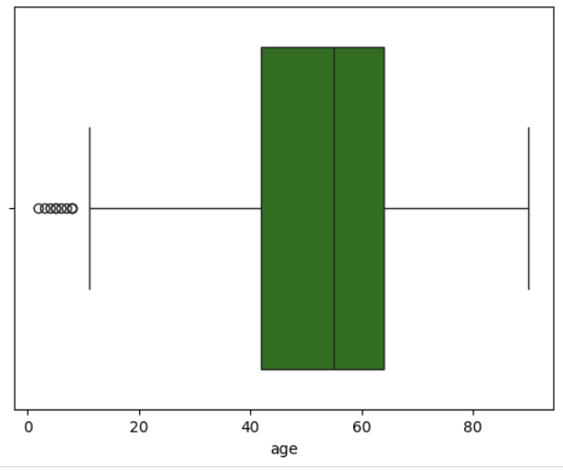
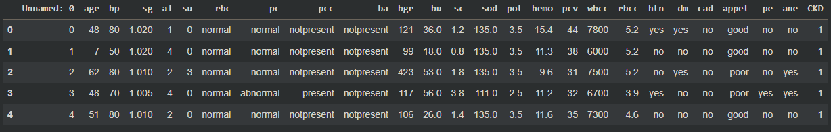
Data Preprocessing
Dataset
Data Cleaning
The dataset used for this model retrieved from [ UC Irvine Machine Learning Repository ]
Removed redundant column and handled missing values.
Encoded categorical features using LabelEncoder.
Handled outliers in numerical features using the IQR method.

Slide 4

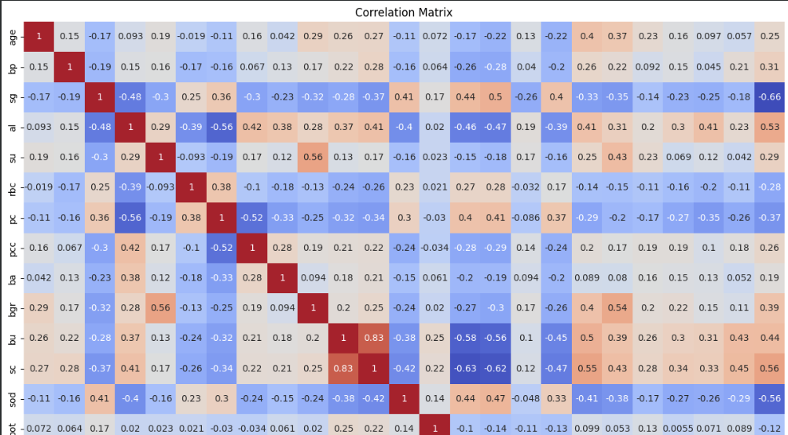

Feature Selection and Model Building
Feature Selection
Based on correlation values ≥ 0.29 with CKD.
Model: Logistic Regression
Baseline model trained with limited iterations (max_iter=10).
Tuned model using GridSearchCV for optimal C value.

Slide 5
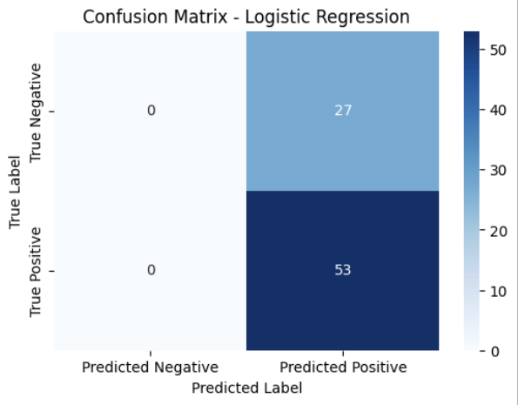
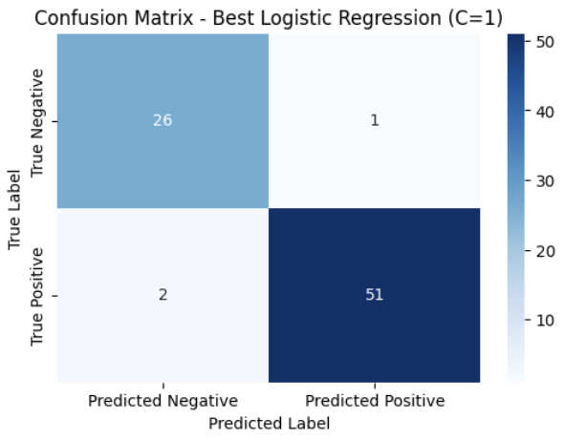
Model Performance
VS
Baseline Model Accuracy
Tuned Model Accuracy

Slide 6
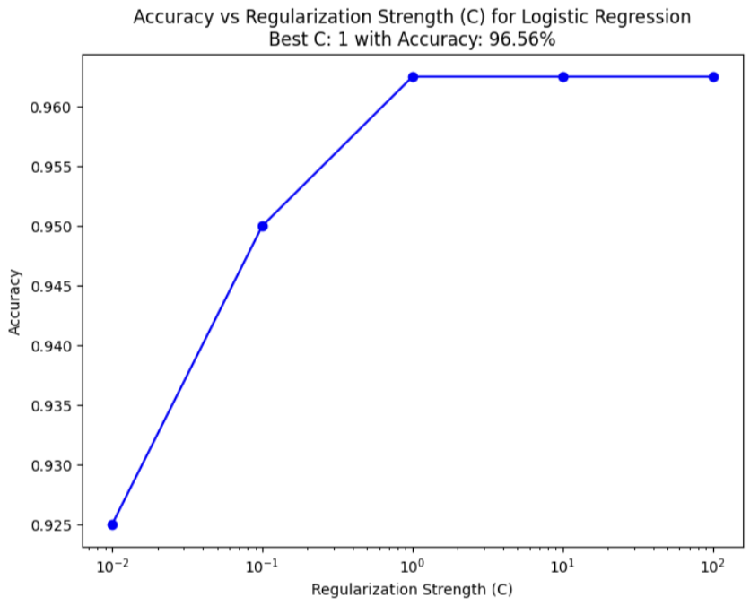
Accuracy vs. Regularization Strength
Regularization Strength (C): Low C values increase regularization, reducing overfitting but lowering accuracy. High C values reduce regularization, improving fit but risking overfitting.
Optimal C: The best C value found is {best_C}, achieving the highest cross-validation accuracy.
Trend Observation: Accuracy initially improves with increasing C, peaks at the optimal value, and then stabilizes or declines due to overfitting.
Deployment Insight: Using the optimal C ensures the model balances accuracy and generalizability.

Slide 7
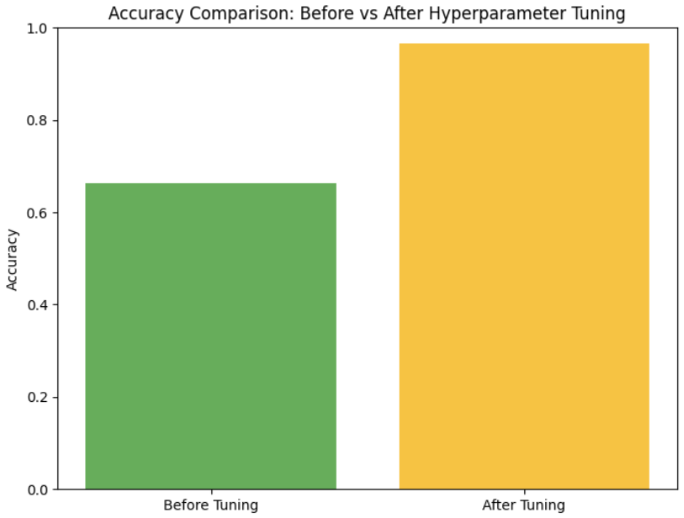
Key Outcomes and Conclusion
Methodology
Achieved improved accuracy after hyperparameter tuning.
Saved the model for deployment (best_logistic_model.pkl).
The tuned model offers robust predictions for CKD detection.
Future Scope
Integrate additional features and test on a larger dataset.

